Slide 1
Big Pixel Initiative develops Remote Sensing Analysis to help map Global Urbanization
Yash Choudhary
704630134

Slide 2
Outline
Describing the fundamentals: What is Big Pixel Foundation? Why map Urbanization?
How do we go about mapping Urbanization?
Technical details followed by Big Pixel Foundation to carry out an efficient classification.

Slide 3
What is the BIG PIXEL INITIATIVE?
“The Big Pixel Initiative is developing geospatial capacity to address our world’s greatest challenges at scale. Founded in partnership at UC San Diego’s Qualcomm Institute (Qi) and the School of Global Policy and Strategy, we have partnered with the DigitalGlobe Foundation to grow a living, learning laboratory related to everything spatial, to investigate and design best practices in geospatial data visualization, user experience interfaces, and design techniques for scientific discovery and decision-making.”[1]
Geospatial data visualization is the process of analyzing geo spatial data through the use of interactive visualization(Like Google Earth, Earth Browser) and drawing conclusions about economic, biodiversity and other fields.
Notes:
[1]: http://bigpixel.ucsd.edu/

Slide 4
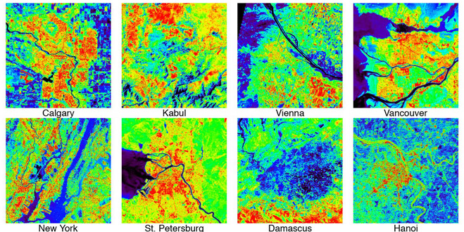
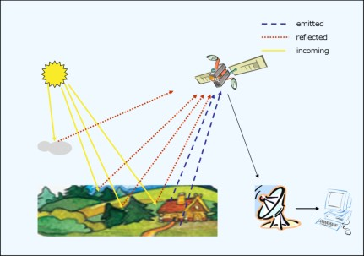
What is Remote Sensing Analysis?
“Remote sensing refers to technologies for gathering visual information or other data about a site from the air or from space.”[2]
This mainly includes aerial photo methods, satellite imagery. It is the basis for geospatial data visualization.

Slide 5
Urbanization and why we need to analyze it?
Urbanization is the shift of population from rural to urban areas.
Urbanization often occurs in an unplanned and uneven manner, resulting in profound changes in patterns of land use. Urbanization is really important in terms of economics, social development, policy and biodiversity. Thus, an analysis of urbanization could be used in many fields including science, finance, politics etc.
They provide, for the first time, a reliable and comprehensive open-source data for detecting and mapping urban areas through satellite images.
There is a lack of ground truth data sets for urban areas and such a study would account for a better understanding of how cities expand and evolve.

Slide 6
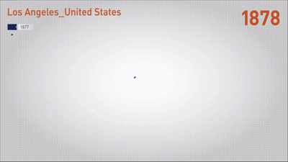
How to map Urbanization?
Some previous methods that were used to map Urbanization include seeing trends in Socio-economic data, nighttime lights and mobile-phone antenna records. –lot of room for error
Recently, we are using satellite imagery that provides spatial and temporal resolutions which makes it easier to analyze data. The satellites we retrieve data from are Landsat and MODIS.
Analyzing spatial data from the satellites using engines like Google Earth Engine (GEE), scientists are able to analyze and learn a trend in urbanization by making the engine learn the general pattern using Machine learning strategies.

Slide 7
Mapping Urbanization by Big Pixel Initiative
As an experiment, researcher Ran Goldblatt worked on analyzing Urbanization in India and recorded his work in the article, “Detecting The Boundaries Of Urban Areas In India: A Dataset For Pixel-Based Image Classification In Google Earth Engine”.
Worked on detecting and quantifying Urbanization at scale using satellite imagery and cloud-based computational platforms.
1. Divide map randomly into 21,030 polygons and assign BU and NBU areas.
2. Analysis of BU Area using computational platforms like Google Earth Engine (GEE)
3. Training the Classifiers
4. Mapping the Classification
5. Mapping Trend across time.

Slide 8
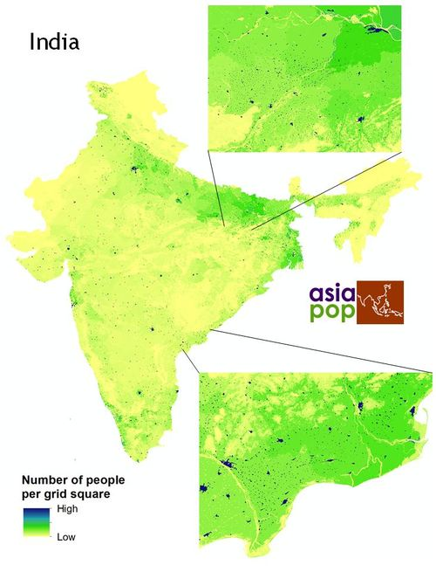
1. Dividing map into Polygons
Goldblatt divided land into 2 parts: Built-Up (BU) and Non Built-Up (NBU) which is used to classify images and detect urban areas. We define BU areas as those where the majority of space (more than 50%) is paved or covered by human-made surfaces and used for residential, industrial, commercial etc. purposes. All other land is defined as NBU.
We begin with WorldPop, which gives us a population distribution graph of India per pixel in a spatial resolution of 100m. Comparing Google Earth satellite imagery and WoldPop dataset gives a threshold value of 40 people per hectare (pixel). Thus, 40 persons per pixel now represents any area with a high population.
We use a Pixel based approach where each pixel is evaluated.
Then, we extract clusters of neighboring pixels whose values are greater than or equal to 40. These clusters represent highly populated areas and are converted into a vector format (polygons).

Slide 9
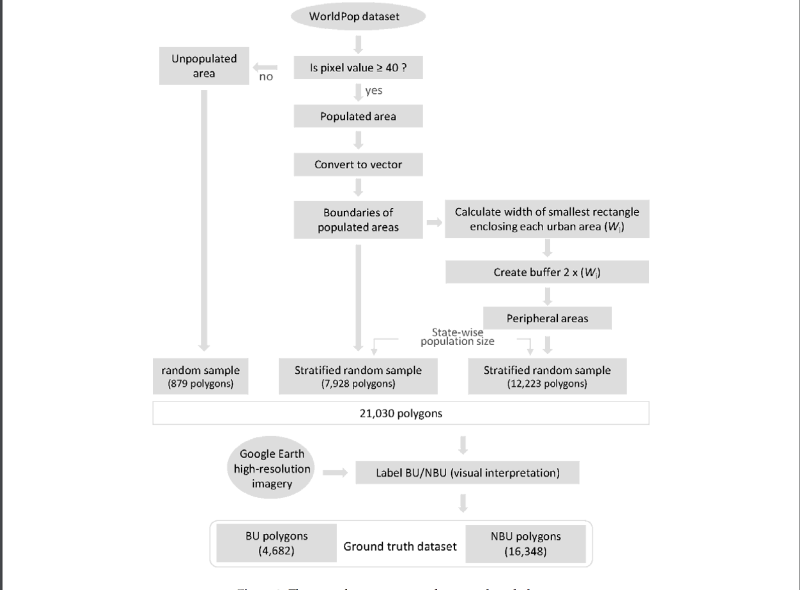

Slide 10
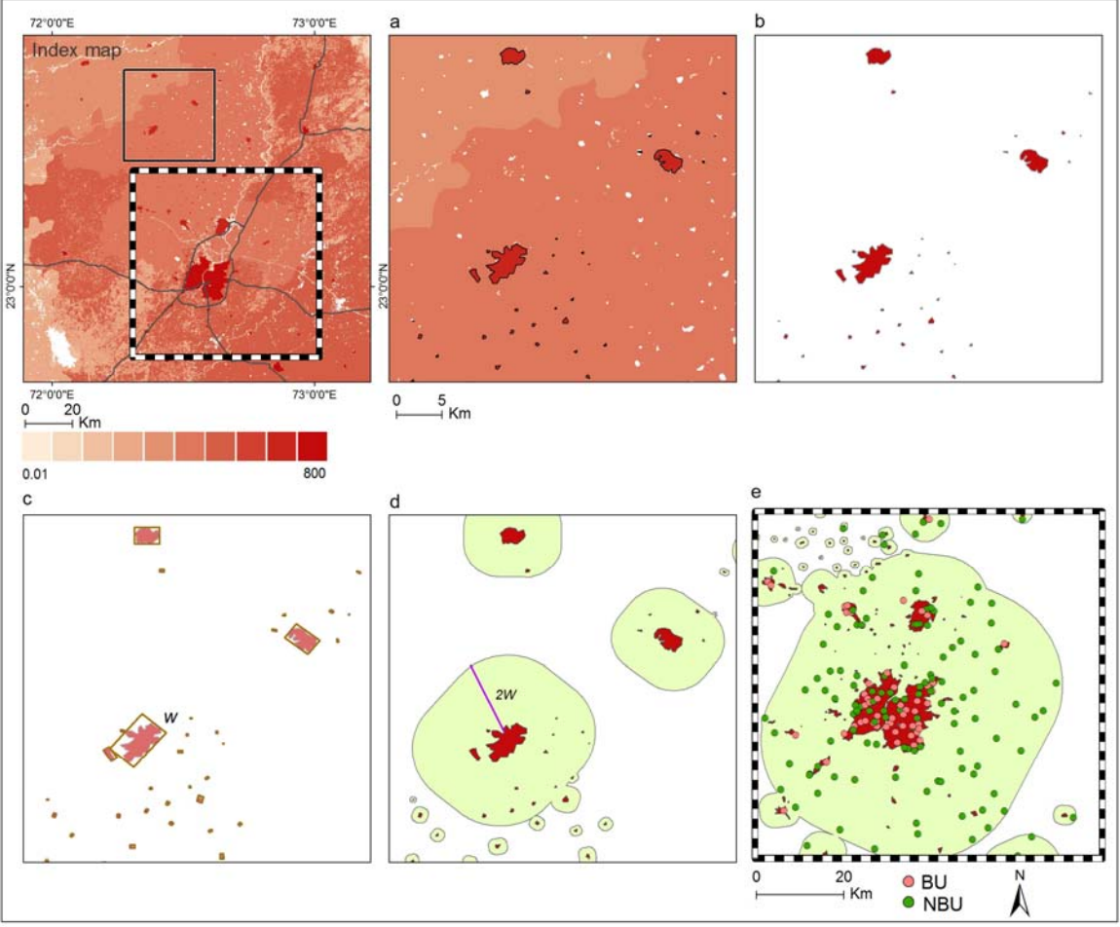

Slide 11
2. Analysis using GEE
Once the map is divided into polygons, we need to analyze and classify the polygons.
The GEE has classifiers which help to classify land as BU or NBU based on the data that was used to “train” the classifiers.
First, we overlay the labeled polygons as the input. We collect all LandSat (satellite) pixels within the regions of these polygons. These variables are the input for the classifiers.
Thus, the LandSat data trains the classifiers and it can then accordingly set the polygons as BU or NBU.
We use this set to train, test and evaluate the performance of the classifiers.

Slide 12
3. Training the Classifiers
The performance or the accuracy of a classifier refers to the probability that it will correctly classify a random set of examples.
To achieve a good “fair” accuracy, the data being tested on the classifier should be separated from the data being used to train the classifier.
Thus to train the classifier a k-fold cross validation procedure is used. Thus, in each of the test examples, one of the folds is left out as the ‘test’ fold and the remaining k-1 folds are used as the training folds.

Slide 13
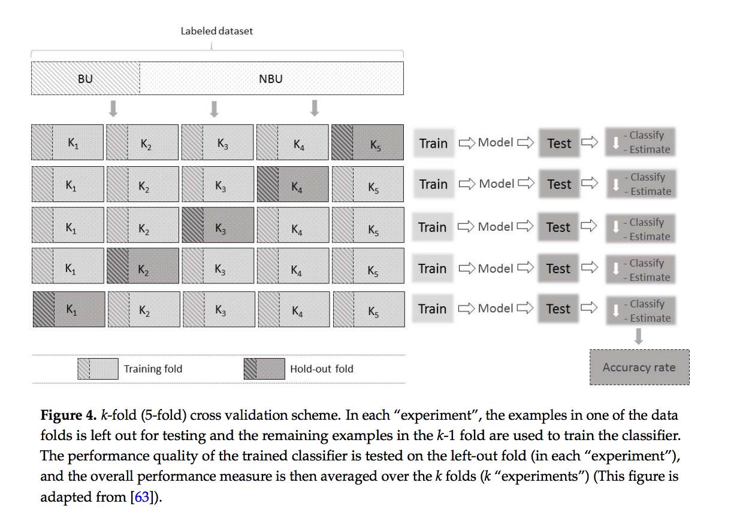

Slide 14
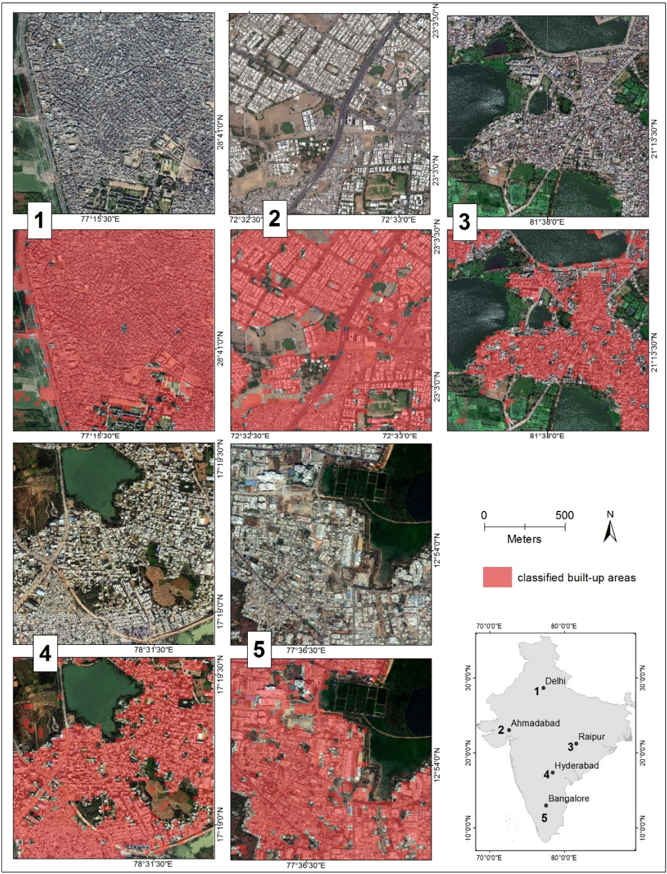
4. Mapping the Classification

Slide 15
5. Mapping trend across time
The classifier can be used to map urban areas over a span of time. For comparing 2014 landscape to 2000 landscape:
1. We first train the classifier by inputting imagery from LandSat filtered to 2014.
2. Next, we run the classifier to map the urban areas in 2000 ( based on Lansat filtered to 2000 ).
Since the classifier had ‘learnt’ the landscape of the 2014 imagery, it divided the polygons and labeled then BU/NBU almost accurately for the 2000 imagery.

Slide 16
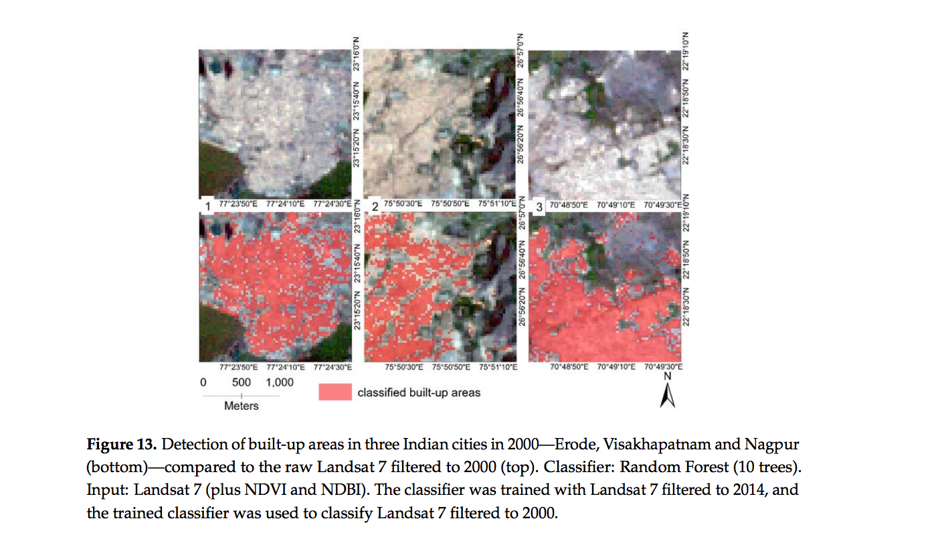

Slide 17
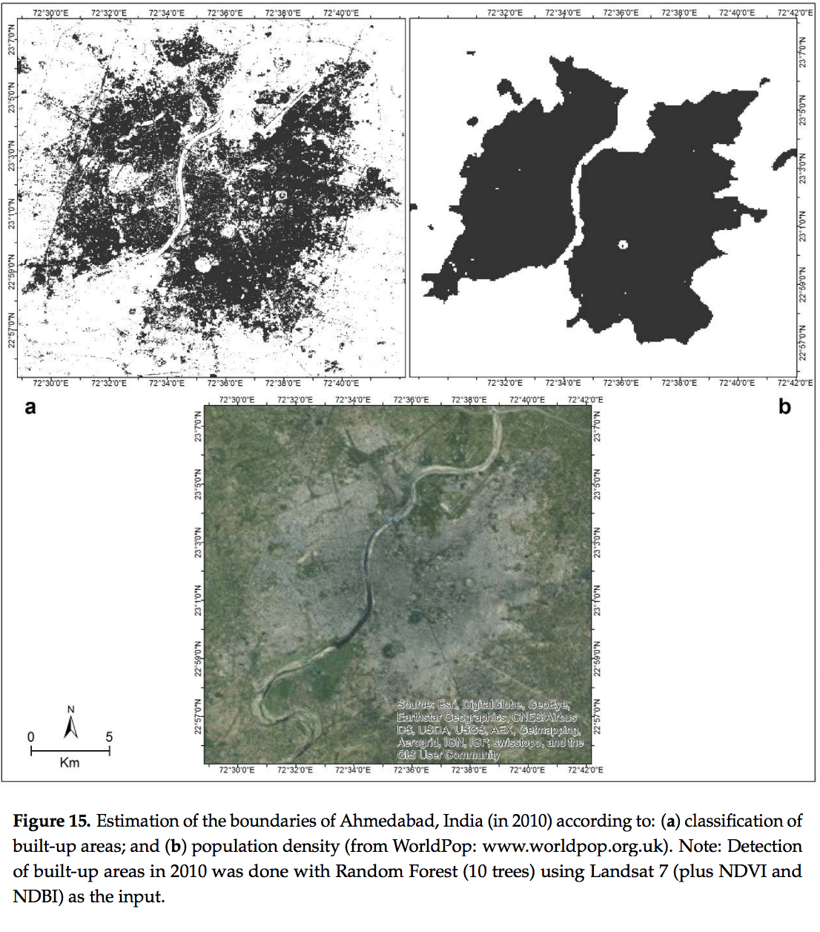
Here we compare the classification between the classifiers of GEE and WorldPop. As we can see WorldPop shows only the population based on the area, whereas the classifiers give us a clear idea about if it is a BU or NBU, and how many people are distributed in the BU. Thus, classifiers are more beneficial to use when we want to map Urbanization.

Slide 18
Conclusion
The increasing availability of satellite imagery at different spatial and temporal resolutions and GEE has shifted urban research towards the use of digital, multispectral images and the development of remote-sensing image classification methods designed to capture urban land features, such as non-vegetative, human-constructed elements
Incorporating nighttime-light data, socio-economic variables, and physical/geographical characteristics to satellite imagery may offer opportunities to improve the accuracy rate of classifiers. Further extensions to our approach may also include the application of learning algorithms and evaluation with various tuning parameters of the classifiers.

